Slide 1

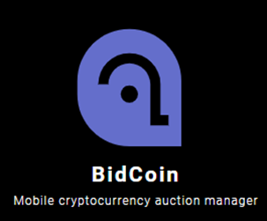

CO225 : SOFTWARE CONSTRUCTION
GROUP PROJECT – GROUP 05
Cryptocurrency Auction Management System

Slide 2



OUR TEAM
FERNANDO K.A.I. – E/18/098
FERNANDO K.N.A. – E/18/100
JAYASUNDARA J.W.K.R.B. – E/18/155

Slide 3
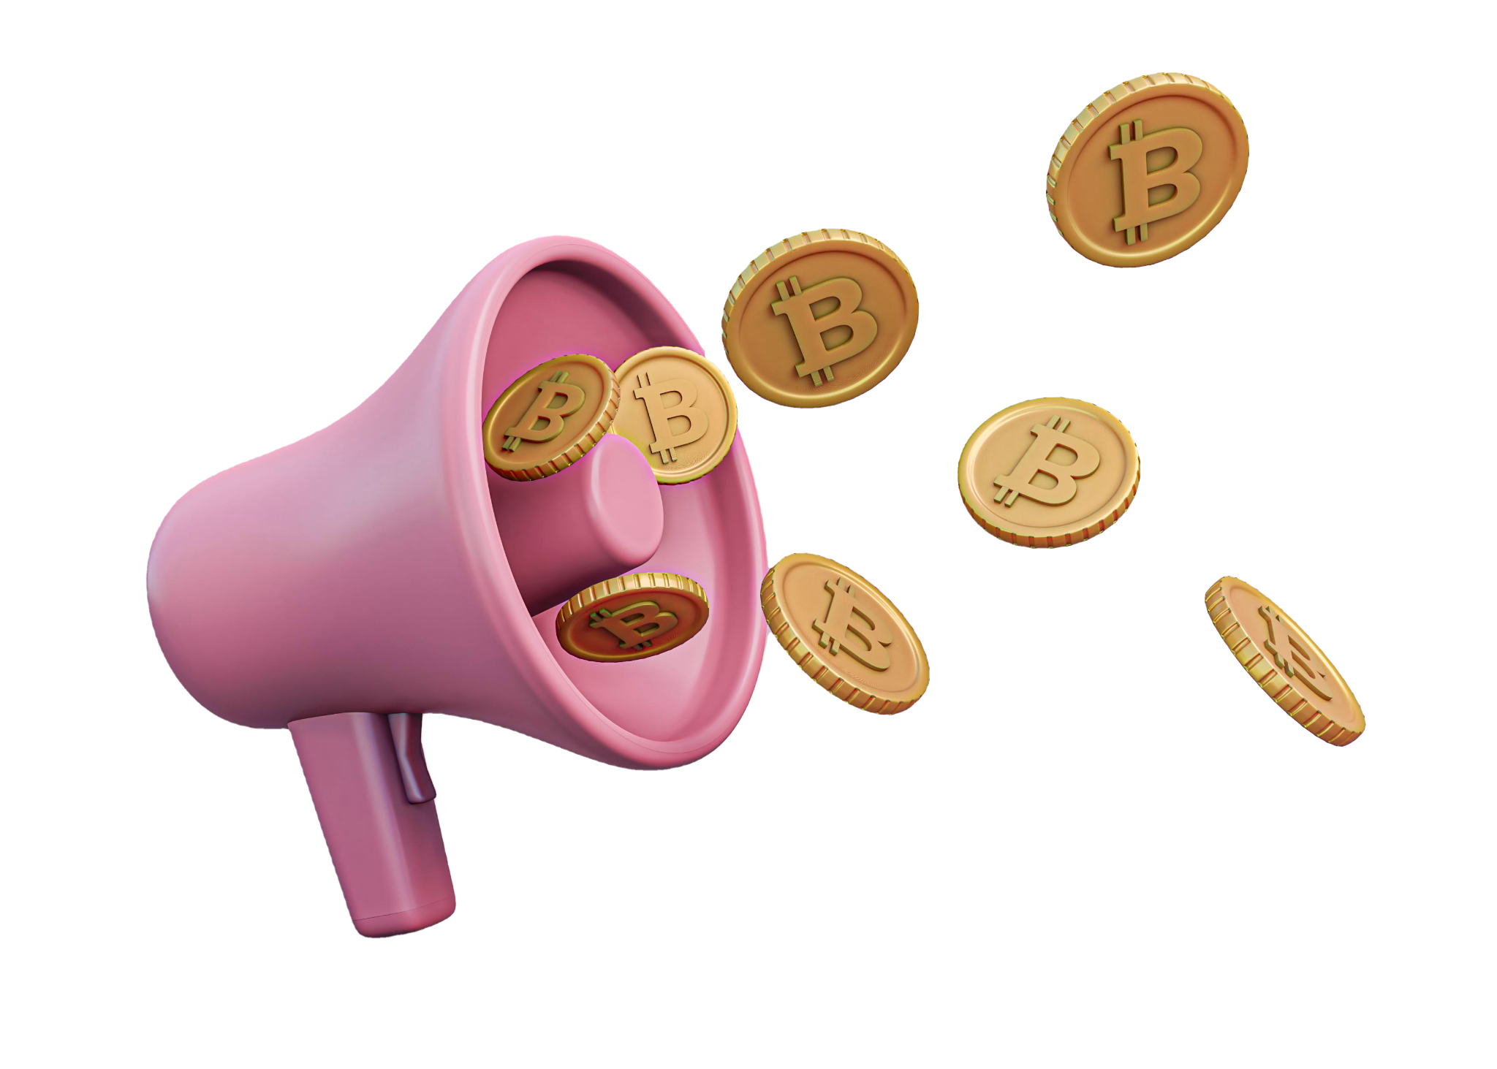
CONTENTS
Project Identification
Objectives
High Level System Organization
Data Flow
Data Storage
Flow Control
Technology Stack
Project Plan
Extendability
Versioning and Documentation

Slide 4
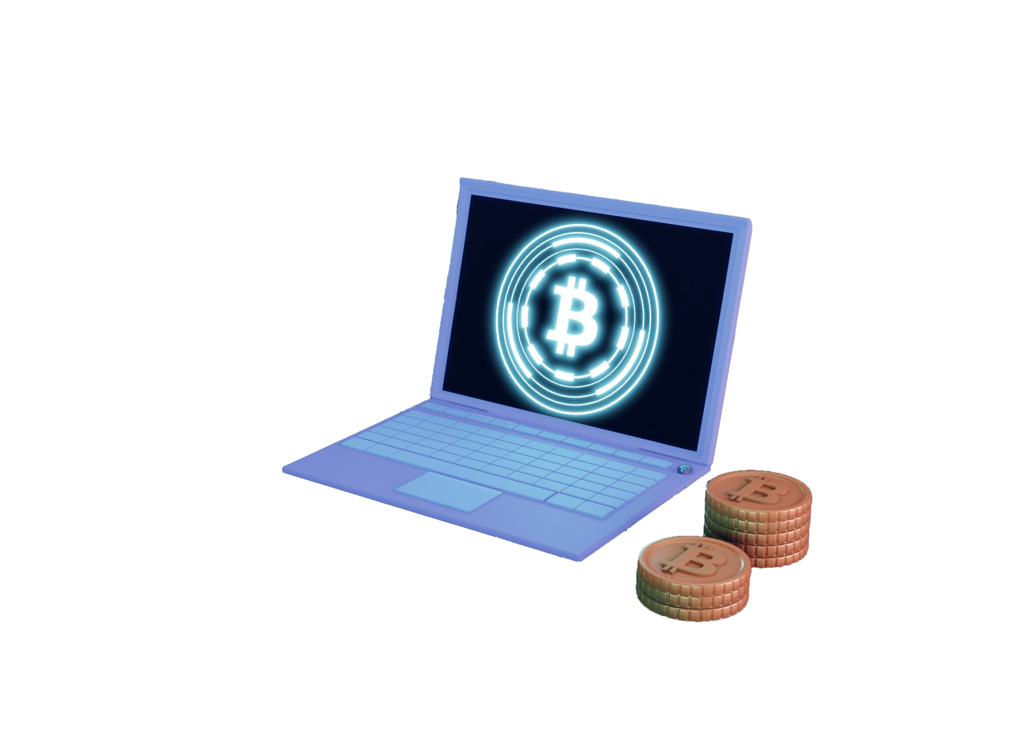
1. PROJECT IDENTIFICATION
Create a user friendly platform to bid cryptocurrency.
Bringing all the tools in to one place (checking prices, ongoing bids, new bids)
To implement a mobile app to bid cryptocurrency.
Identify top ranked cryptocurrencies.

Slide 5
1. PROJECT IDENTIFICATION
Users :
1. Administrators
2. Bidders
Events :
1. Start auction (Administrators)
2. Cryptocurrency selection (Bidders)
3. Bidding (Bidders)
4. Stop/End auction (Administrators)

Slide 6
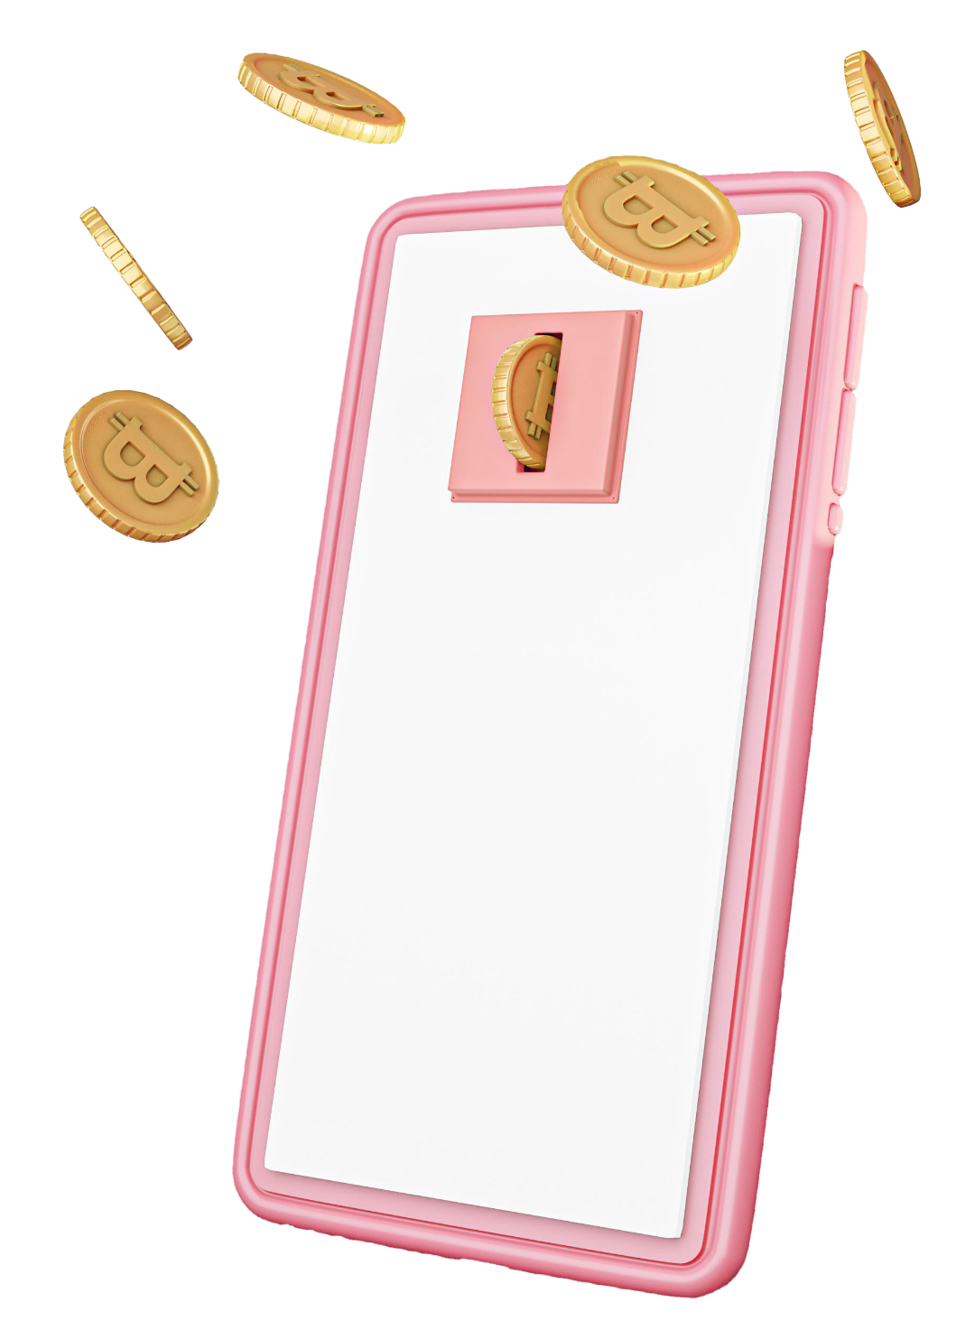
2. OBJECTIVES
Android mobile app development applying java concepts :
- Collection
- OOP
- Input/Output
- Exception Handling
- Event Handling
- Concurrency
- Sockets
Designing the Solution Architecture understanding the Data & Control flow. ( Data Flow and Storage)
Learning all the technologies required to implement a real-life application. ( Technology Stack)
Project planning and Documentation. (Project Wiki)
Learn version controlling and group collaboration in software projects. (Git, GitHub)
Notes:
2min

Slide 7
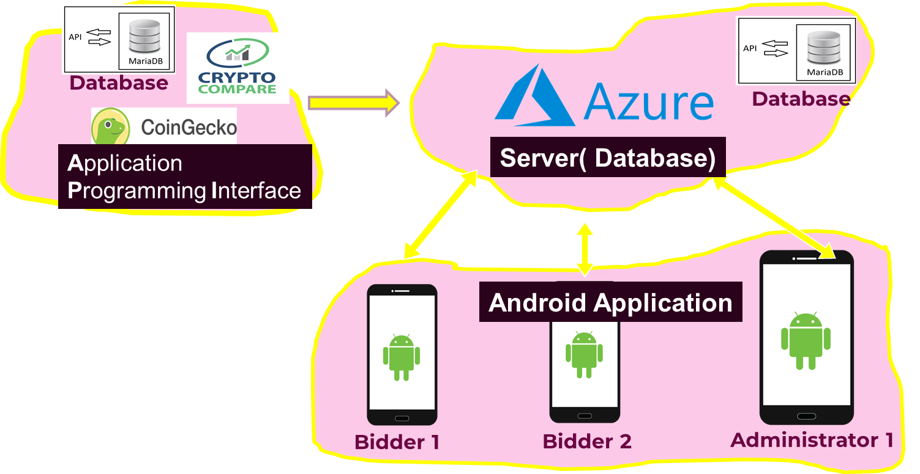



3. High Level System Organization

Slide 8
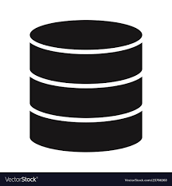
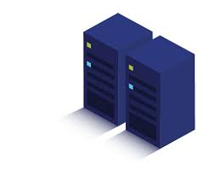
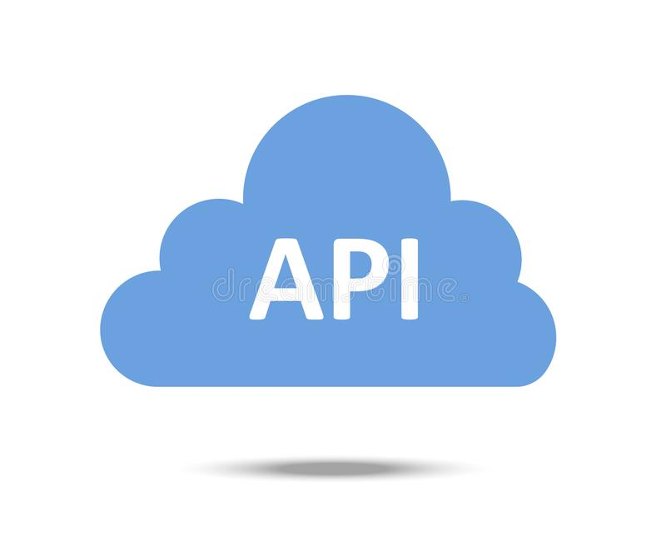

4. DATA FLOW
API DB
Our Server
User
User
(Bidder)
(Administrator)

Slide 9

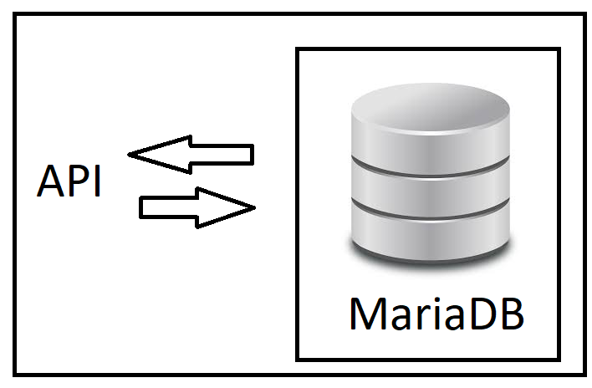


5. Storage of data
Server
(Permanent storage)
MariaDB -
Temp Storage
(Refreshed when app is opened)
RAM -
Bidder
Admin

Slide 10
6. Flow control
Server
3
4
2
1
Bidder inserts the first bid
App sends req to server ( 1 )
Server sends req to CryptoCompare API( 2 )
API sends data to server back( 3 )
Server creates record in DB( 4 )
Server Sends reply back to Bidder( 5 )
Mobile shows the data in an organized way
5
Bidder
Admin
Notes:
5min total - 7min

Slide 11




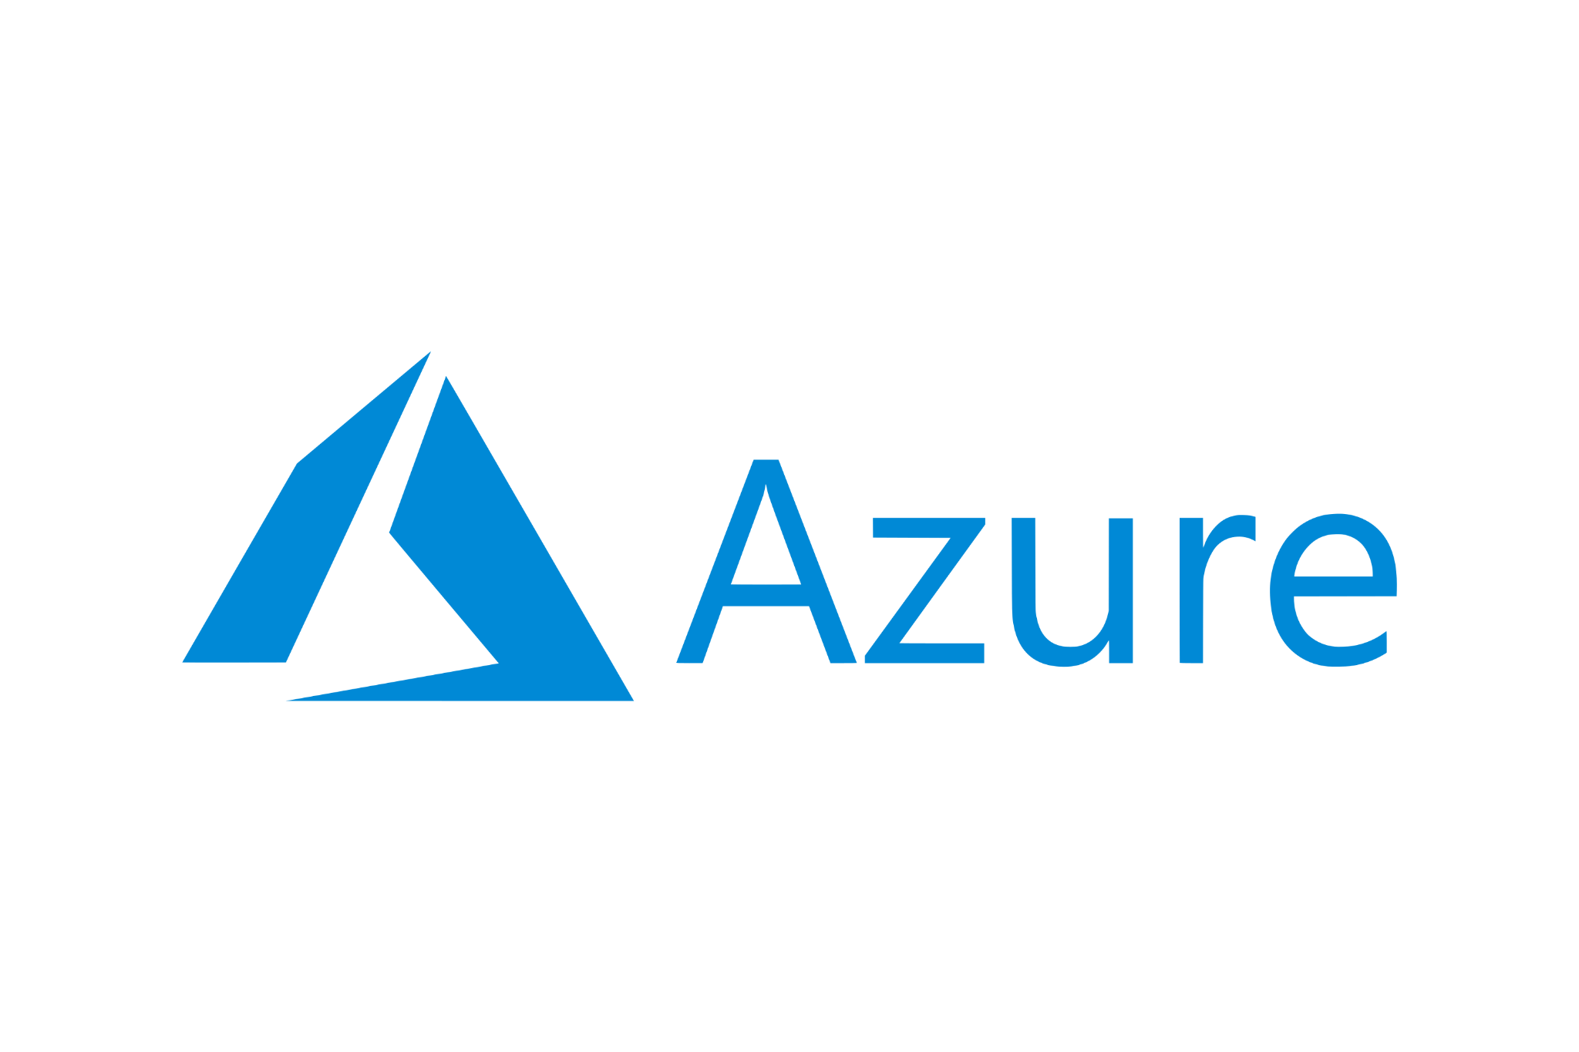
7. Technology Stack
Android (Android Studio) - Java
For creating android application
Java Spring Framework
For easier server side application development
Microsoft Azure for Students (Linux Virtual Instance for server hosting)
Hosting will be managed by us through SSH
Install MariaDB, Maven etc..
Deploy the spring boot application
.tk Free Domain
RESTful API
HTTP - GET / POST etc..
CryptoCompare API - Real Time price of crypto
MariaDB

Slide 12
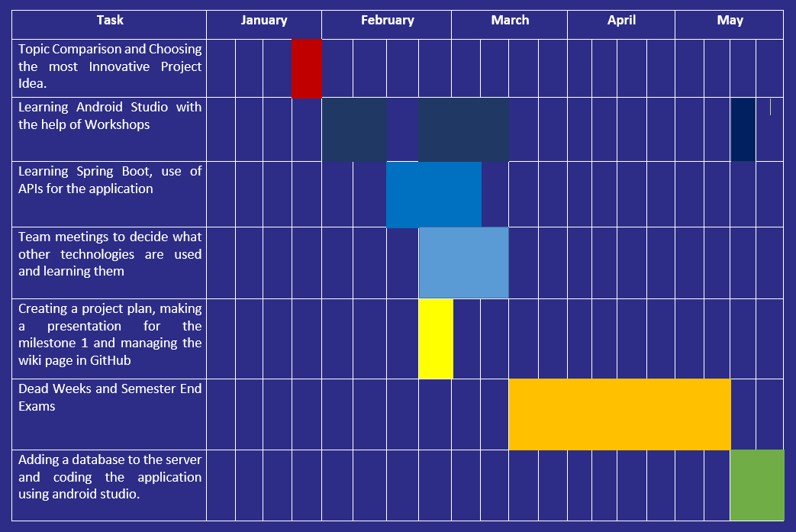
8. Project Plan

Slide 13


9. Extendability
Auction for NFTs
Set starting bid price by admin
User friendly app to get current cryptocurrency values
Notes:
Damn…

Slide 14
Team
Backend - (Microsoft Azure, API, MariaDB, Spring Boot)
FERNANDO K.A.Ishan (E/18/098)
Frontend - (Android application, JAVA)
FERNANDO K.N.Adeepa (E/18/100)
JAYASUNDARA J.W.K.Ridma.B. (E/18/155)
Notes:
strengths and expertise

Slide 15
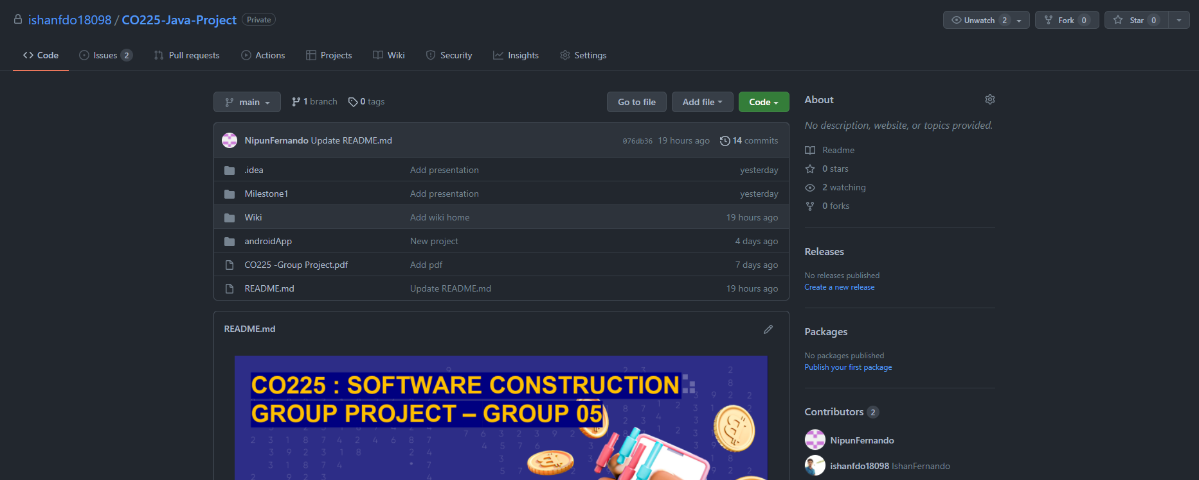
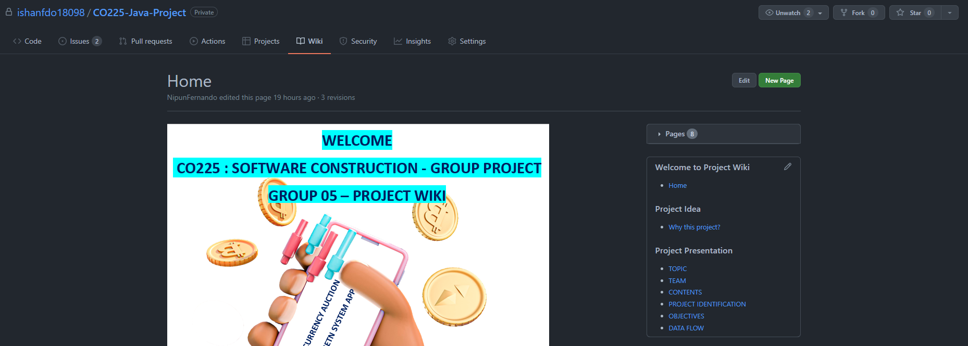
10. Versioning and Documentation
GitHub - https://github.com/ishanfdo18098/CO225-Java-Project
GitHub Wiki - https://github.com/ishanfdo18098/CO225-Java-Project/wiki

Slide 16




Thank you
Bitcoin
Ethereum
DogeCoin
Litecoin

Slide 17
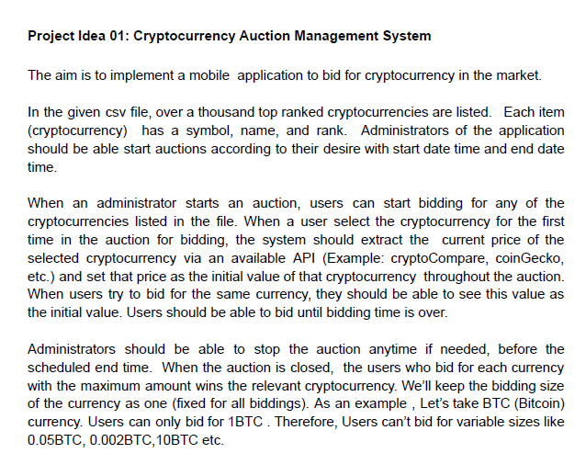
remove when finished

Slide 18
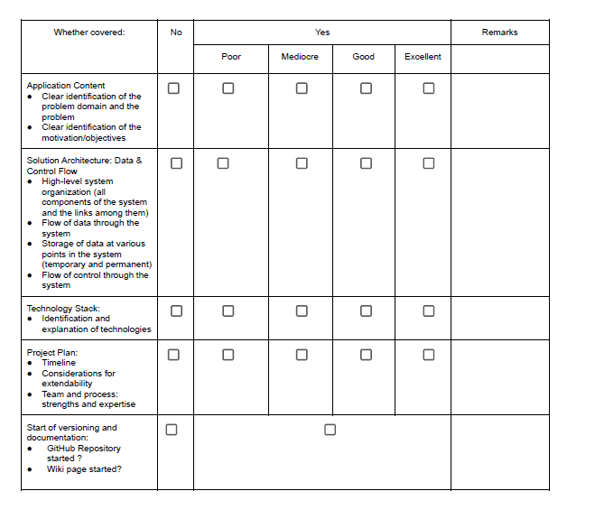
remove when finished

Slide 19
TODOs
Check every pages topic number
Fix slide 3 (contents)
Change technology stack into pic

